Slide 1
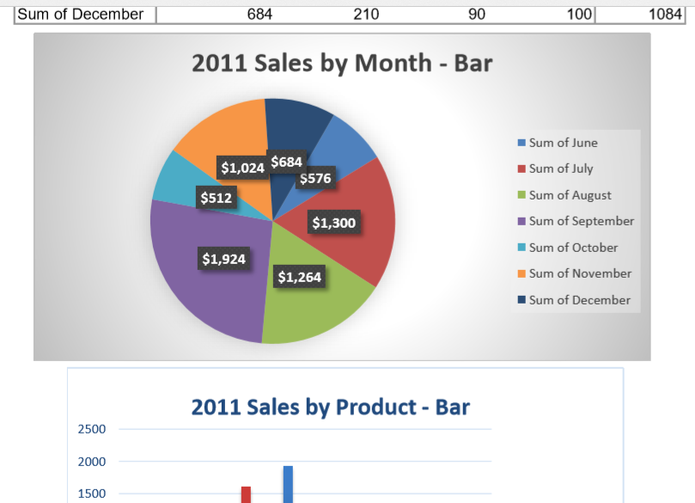
Example Visual Analysis

